Slide 1
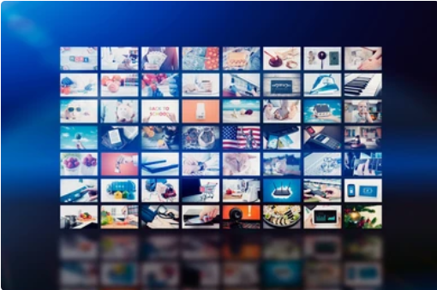
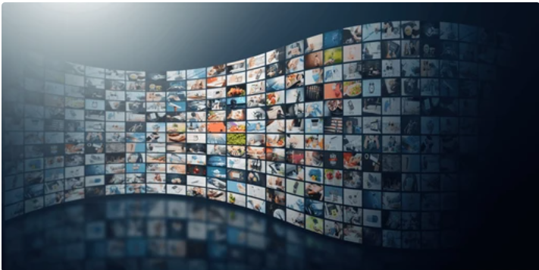

Video in Multimedia
Introduction
Video is a key component of multimedia that integrates moving images with sound.
Used in various fields like entertainment, education, marketing, and communication.
Formats: MP4, AVI, MOV.

Slide 2



Types of Video Content
Animation: Animated videos simplify complex ideas, often used in education.
Live-Action : Live-action videos engage viewers by showcasing real events.
Info graphics with Video : Combining info graphics and video enhances data visualization.
Interactive Video : Interactive videos allow viewer choices, enhancing engagement.
Screen Recording: Captures digital screen activities for tutorials and demonstrations.

Slide 3
1
Enhanced Engagement
People retain more information from videos compared to text or images alone.
Advantage of Video in Multimedia
2
Visual Explanation
Videos can simplify complex topics through visual representation, making them easier to understand.
3
Improved Learning Outcomes
Studies show that learners retain information better when it is presented through video.
4
Case Study Example
A non-profit organization used video storytelling to share client success stories.

Slide 4



Challenges of Video in Multimedia
High Production Costs
Producing high-quality videos can be expensive, deterring smaller organizations from utilizing this medium.
Prioritizing Quality Over Quantity
Focusing on quality rather than volume is crucial for maintaining viewer interest and engagement.
Compatibility Issues
Different formats may not work on all devices or platforms

Slide 5


Slide 6


